Slide 1
ROAD CROSSING ASSISTANT FOR BLIND
RISHIRAJ . R
SUDHARSHAN . D
SURUTHY . R
PALANIAPPAN . M
College: RAJALAKSHMI ENGINEERING COLLEGE
Dated : 16/10/2020

Slide 2
Problem Statement
Crossing at urban intersections is a difficult and possibly dangerous task for the blind
Infrastructure modification (such as Accessible Pedestrian Signals) not possible universally
Most solutions use image processing:
  Inherent difficulty: Fast image processing required for locating clues to help decide whether to cross or wait → demanding in terms of computational resources
  Mobile devices with limited resources fall short alone
Notes:
Crossing at urban intersections is a difficult and possibly dangerous task for the blind people, which hinders independent safe navigation. Assistive technology researchers have been working on this problem for years, but not many of the proposed solutions have been widely adopted. The currently widespread solution, which is also known as an accessible pedestrian signal (APS), uses a special sound/speech output to notify blind people about the status of a pedestrian signal at an intersection. However, this solution requires installation of expensive equipment at the intersections, limiting its applicability. In order to implement this solution, an extra terminal device for controlling the speaker should be added to the current traffic lights infrastructure, and this modification requires large amounts of money as well as time.
Some other proposals to solve this problem use image processing to detect the presence of different kinds of pedestrian signals in a complex scene. The major shortcoming of some of these approaches is their reliance on a cumbersome computation device, like a laptop for the necessary image processing. There are yet some others that lack the universal design principle, by limiting their training data to a specific set, and draining the battery of the mobile device by running the detection algorithm on the device. These approaches also require the user to take a picture or do a video recording at the intersection, although the picture taken by a blind user may not be able to capture the pedestrian signal or crossing.

Slide 3
What needs to be done?
Provide fully context-aware and safe outdoor navigation to the blind user:
  Provide a solution that does not require any infrastructure modifications
  Provide a near-universal solution (working no matter what city or country the user is in)
  Provide a real-time solution
  Provide a lightweight solution
  Provide the appropriate interface for the blind user
  Provide a highly available solution
Notes:
Here are some requirements of a real and widely applicable solution, to the problem of providing fully context-aware and safe outdoor navigation for the blind people. The system developed for this purpose should not require any modifications to the existing infrastructure, as in the case of accessible pedestrian signals. The solution should be universally applicable, for example, it should be able to guide the user whether he is in India or the US. The solution should of course be compliant with the real-time requirements of the problem, as for an application like pedestrian crossing guidance, timeliness of response is critical. The device should not be too heavy to carry around the whole day and should provide an interface that would not obstruct the user’s attention to the environment. The solution should also be highly available, i.e. little to no interruption in service should be experienced by the user.

Slide 4
Attempts to Solve the Traffic Lights Detection Problem
Kim et al: Digital camera + portable PC analyzing video frames captured by the camera [1]
Charette et al: 2.9 GHz desktop computer to process video frames in real time[2]
Ess et al: Detect generic moving objects with 400 ms video processing time on dual core 2.66 GHz computer[3]
Sacrifice portability for real-time, accurate detection
Notes:
Here we see the details of some previously proposed solutions, for the problem of detecting the status of traffic lights at street intersections. As we see here, all of these image processing based solutions require quite heavy devices for the processing, hence they sacrifice portability for real-time accurate detection of traffic lights.

Slide 5
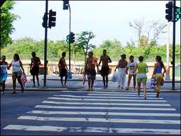


Proposed Solution
Android mobile device:
Running outdoor navigation algorithm with integrated support for crossing guidance
Cross/wait
Amazon EC2 instance running crossing guidance algorithm
Auto-capture image at intersection as determined by the GPS signal & Google Maps
Correctly position user at intersection to capture the best possible picture
Notes:
The Mobile-Cloud computing solution we propose for this problem, has the simple system architecture we see on this slide. The two main components are the mobile device with integrated GPS receiver and compass, and the cloud server, which is responsible for processing the image frames received from the mobile device.
We have chosen Android as the mobile platform due to its open architecture, support for multi-tasking and accessibility features. Android based devices come with integrated speech recognition and text-to-speech engines, which will be of help for the development of an easy-to-use interface for the blind users.
The proposed crossing guidance system works as follows:
The Android Application captures the GPS signal and communicates with the Google Maps Server, to determine the current location of the blind user.
Once the application detects that the blind user is at an urban intersection, it triggers the phone camera to take a picture, and send the picture to the Server running on the Amazon EC2 Cloud.
The server then does the image processing, applying the Pedestrian Signal Detection algorithm, and returns the result about whether it is safe for the blind user to cross the intersection.
If the result is positive, the Android Application notifies the blind user to cross the intersection with speech feedback.

Slide 6
System Components
Android application: Extension to the Walky Talky navigation application to integrate automatic photo capture at intersections
Compass: Use of the compass on Android device to ensure correct positioning of the user
Camera: Initially the camera on the device to capture pictures at crossings → camera module on eye glasses communicating with the device via Bluetooth as future work
Crossing guidance algorithm: Multi-cue image processing algorithm in Java running on Amazon EC2
Notes:
Here are the basic components of the proposed system:
We extended an open source navigation application named WalkyTalky by the Eyes-free group at Google, which navigates the user to his destination using GPS and Google Maps, and we integrated crossing guidance to this application. The automatic image capturing function was also added to the application.
In order to make the detection more accurate, we enabled the Compass function in the application. The reason for using the Compass function is obtaining the heading direction of the blind user to correctly position him at the intersection.
During the implementation of the current system, the native Android camera was used to take the pictures at street intersections. However, in future work we will be employing camera modules integrated into glasses worn by the user. This is considering the fact that the placement of the camera is of vital importance, for collection of context-relevant data, and an eye-level placement is the most natural. We are also considering the placement of camera modules on the sides of the glasses for even better context-awareness.
The Elastic Compute Cloud service of Amazon Web Services was used to host the cloud component of our system, where the server receives video frames from the Android mobile device, processes to detect the presence and status of pedestrian signals in the frame, and sends a response back to the mobile device over a TCP connection. We chose to use the Amazon platform in this project, due to its proven robustness and ease of use.

Slide 7
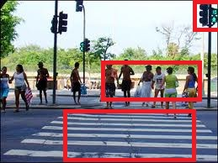
Multi-cue Signal Detection Algorithm: A Conservative Approach
Ref: http://news.bbc.co.uk
Notes:
We are currently investigating the effectiveness of a multi-cue algorithm, in providing accurate guidance to the user at intersections. As seen in the figure here, the presence of contextual clues including other pedestrians crossing in the same direction, a zebra crossing and the status of traffic lights in the same direction, provide additional information to make an accurate decision about whether the user should cross. With the help of Cloud Computing, we will be able to run all of these detection algorithms in parallel to make a more informed and conservative decision at the crossing. Another important aspect we will take into consideration in the development of the detection algorithm is the universal aspects of pedestrian signals. As signals in different countries and even different cities can be dramatically different from each other, it will be important to focus on the common features at the image processing stage, instead of training the detector with a dataset of signal images, which may not be comprehensive.

Slide 8
Adaboost Object Detector
Adaboost: Adaptive Machine Learning algorithm used commonly in real-time object recognition
Based on rounds of calls to weak classifiers to focus more on incorrectly classified samples at each stage
Traffic lights detector: trained on 219 images of traffic lights (Google Images)
OpenCV library implementation
Notes:
The pedestrian signal detector of the developed system uses a cascade of boosted classifiers based on the AdaBoost algorithm [8], which is popular for real-time object recognition tasks, to detect the presence and status of pedestrian signals in a picture. Our training set for the pedestrian signal detector consisted of 219 images retrieved from Google Images and we used the OpenCV implementation of the Adaboost object detector.

Slide 9
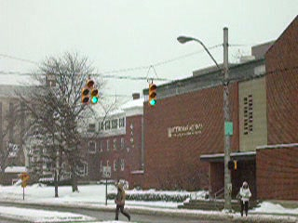
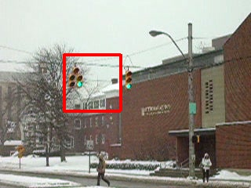
Experiments: Detector Output
Notes:
Here we see a sample from the test set we used for a traffic lights detector at the top and the output of the detector on the sample at the bottom.

Slide 10
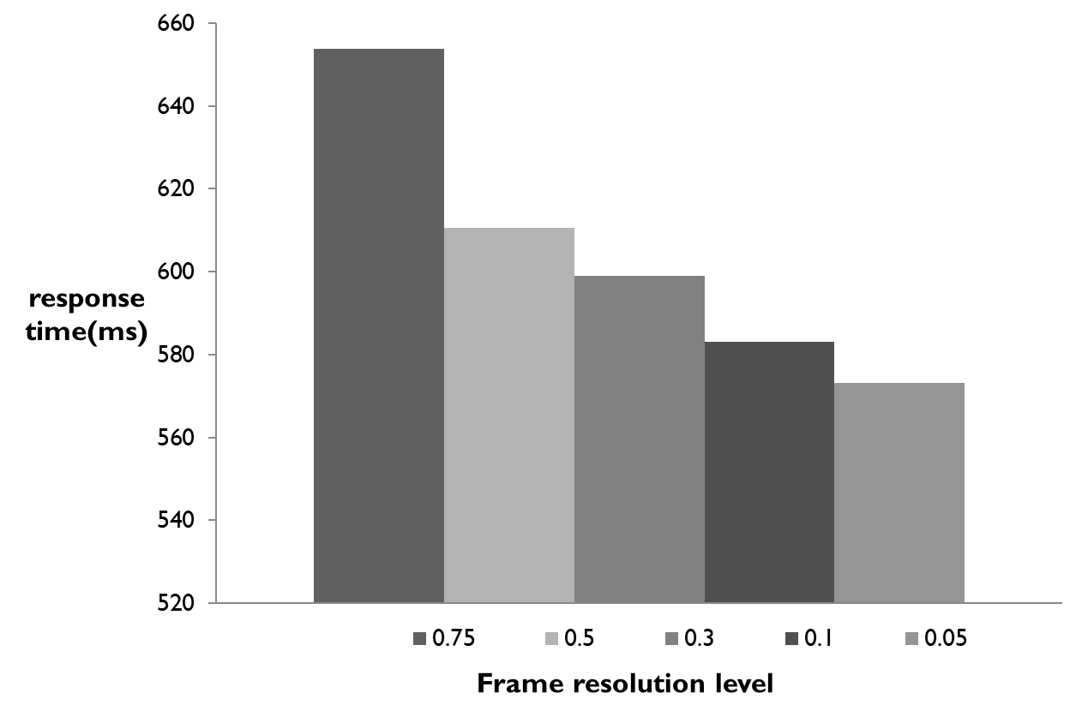
Experiments: Response time
Notes:
The two most important aspects of the pedestrian signal status detection problem are, timeliness of response and accuracy. The real-time nature of the problem necessitates response times of less than 1 second. We performed experiments to test the response time of the pedestrian signal detector application. The application was installed on an Android mobile phone, connected to the Internet through a wireless network on the Purdue campus. The sample task in the experiments involved, processing five different resolution level versions of pictures. The average response times, which were determined by the time period between capturing a frame and receiving the response from the cloud server, were measured for each frame resolution level as determined by a Java platform-specific measure. A resolution level of 0.75 stands for the original frame captured by the camera, whereas the lower resolution levels represent compressed versions of the same set of frames, where image quality falls with decreasing resolution level. The response times for different resolution levels are seen here. Response times for the original frames are around 660 milliseconds on average, which are acceptable levels for the real-time requirements of the problem. We also see that response time decreases further when lower-quality, compressed versions of the frames are sent to the remote server instead of the originals.

Slide 11
Work In Progress
Develop fully context-aware navigation system with speech/tactile interface
Develop robust object/obstacle recognition algorithms
Investigate mobile-cloud privacy and security issues (minimal data disclosure principle) [4]
Investigate options for mounting of the camera
Notes:
This work is still in progress and our aim is, to develop a full context-aware navigation system with a speech or tactile interface, capable of other functions such as indoor navigation, face recognition and obstacle detection. Such a system will require work on robust object recognition algorithms, and we will also need to investigate the privacy issues, arising from the use of Cloud computing in the proposed system. We will also investigate better options for the mounting of the camera, and the most appropriate solution now seems to be placing the camera lenses on sunglasses.

Slide 12
Thank you!
Notes:
Thank you very much for your attention! I would be happy to answer any questions you might have.

